Slide 1
Project 1
William Donayre

Slide 2
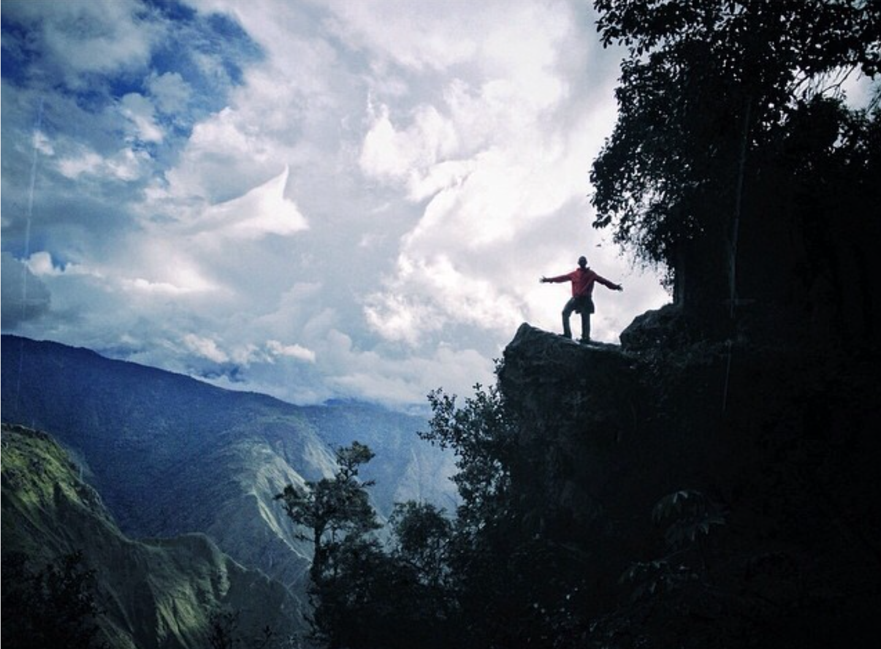
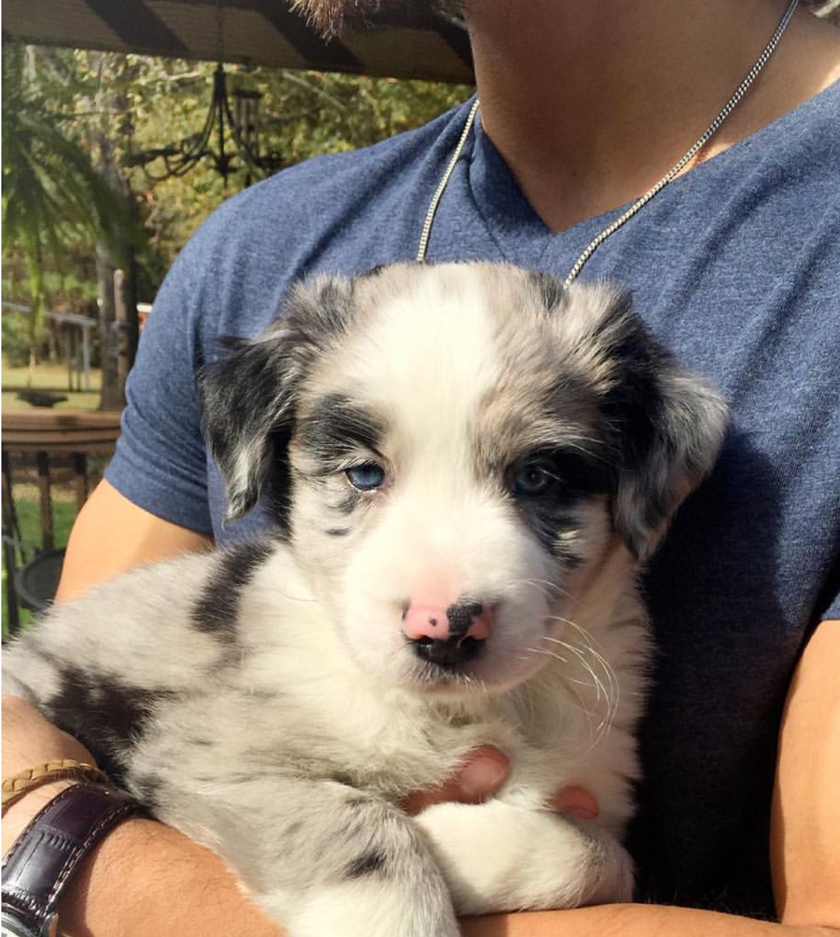
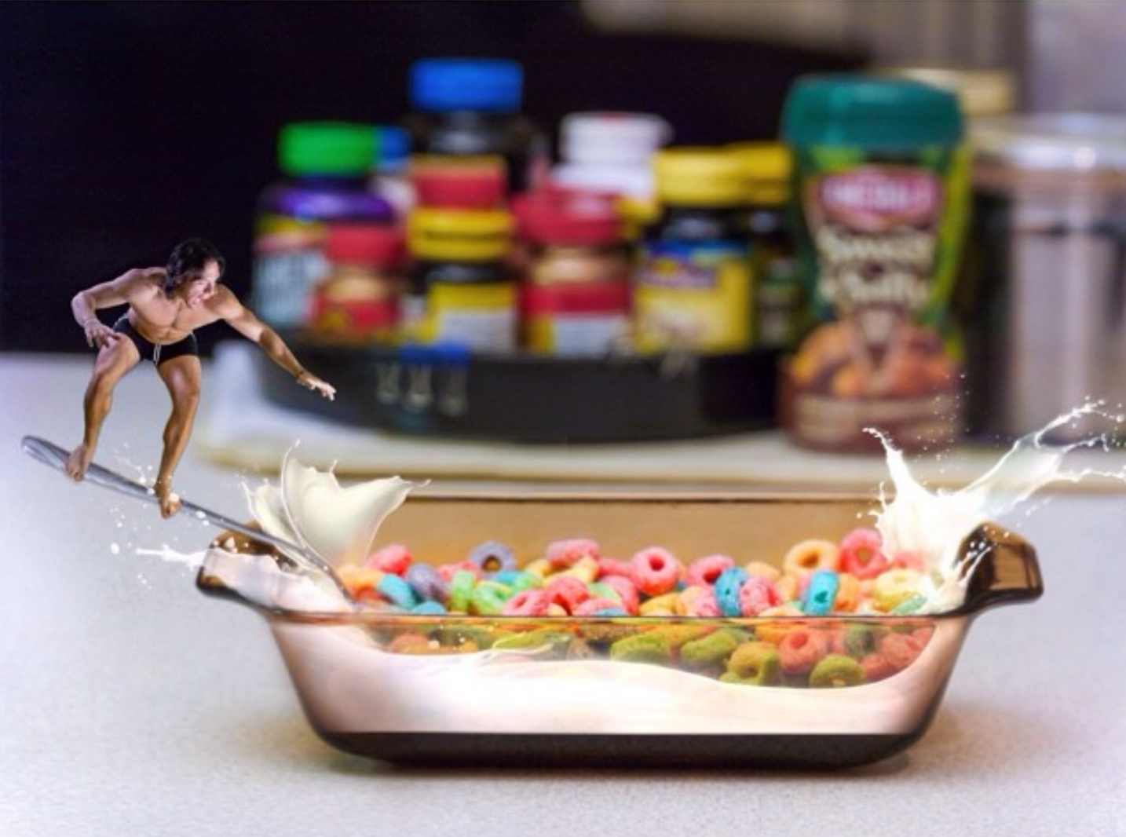
Who are you?
Born in New Jersey and spent most of my childhood in Peru
Photography and graphic editing was a big portion of my free time.
I’m now working in Banking as Financial Analyst for about 3 years
Focus has shifted to cycling and traveling midway through this job to get back into fitness and enjoying the outdoors

Slide 3
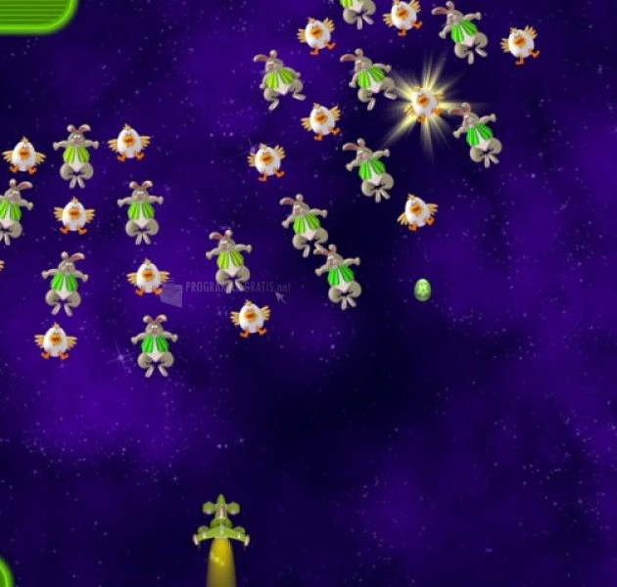
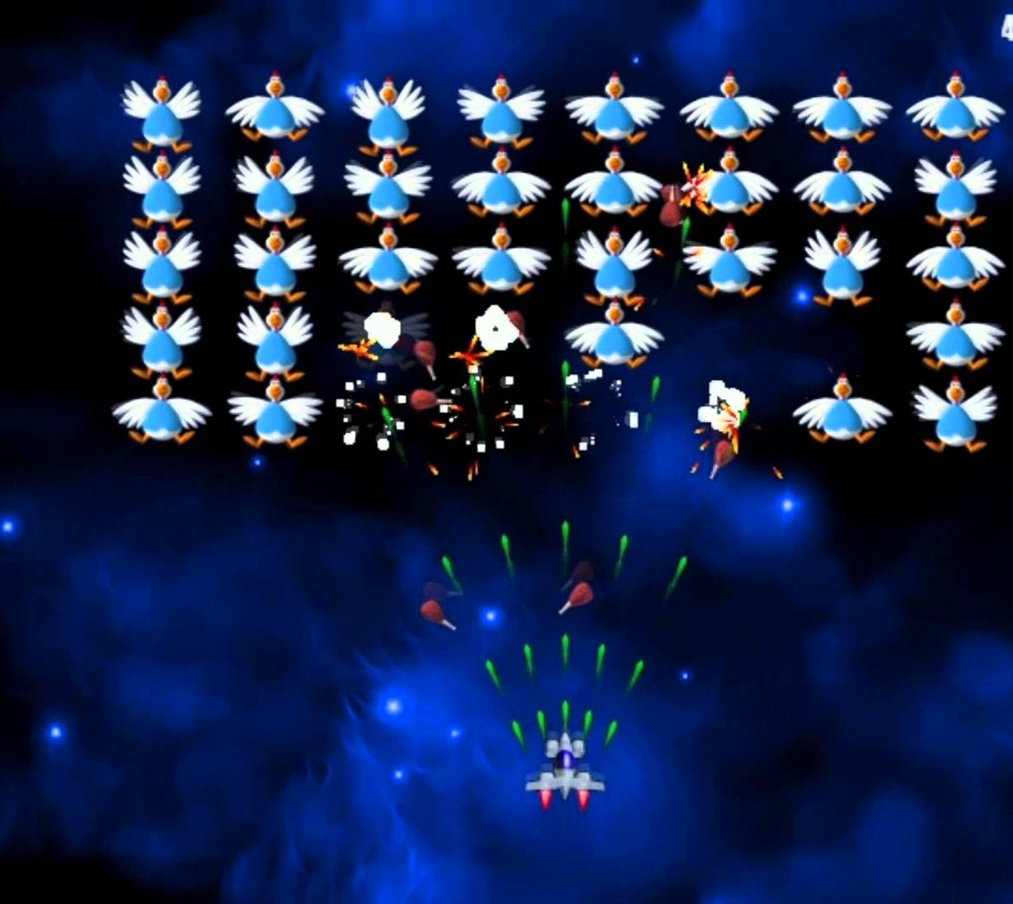
Game Concept
Concept
Recreating space invaders with a twist
Bosses and power up items
Chicken Invaders?
Difficulties
Choosing game to focus one based of the time constraint
P5js or Phaser, many gifs/animations don’t work well in P5js
Swarm animations for the monsters

Slide 4
Game Demo

